Slide 1
DC Crime Patterns: COVID-19 Era and Proximity Insights
Group 3 Team Members:
Nammin Woo
Sasank Reddy Chaganti
Sai Narayana Murthy Dontukurti
Abhishek Pradhan

Slide 2
Contents
Background
Objective
Dataset Description
Data Engineering
Methodology of Crime Analysis
User Interactive Tool
Analysis of Crime Type
Trend Analysis
Methodology of Proximity Feature Analysis
Proximity Feature Analysis
Conclusion
Implication/Future Use
Reference

Slide 3
Background
The COVID-19 pandemic has led to significant socio-economic changes, directly influencing urban crime patterns and safety needs. Analyzing these evolving crime trends is essential for developing adaptive public safety strategies and maintaining community wellbeing.
Advanced GIS tools, including ArcGIS Pro and Python, are employed to spatially analyze and visualize these shifts in crime dynamics in this project.
Another key focus of our study is the proximity of crime incidents to essential urban infrastructures like schools and hospitals, crucial for targeted urban planning and safety enhancements.
As cities navigate the post-pandemic landscape, understanding these crime trends is vital for preparing urban areas to face future challenges and ensure resilient communities.

Slide 4
Objective
Analyzing Impact of Covid on Crime in DC:
To compare and visualize crime incidents in Washington, DC, from 2019 to 2023 across three critical periods: pre-COVID, during COVID, and post-COVID.
To categorize these incidents into four main crime types for focused analysis.
Interactive Analysis Approach:
Development of a user-interactive tool allowing selection of time periods and crime categories.
Utilization of KDE plots for spatial visualization within ArcGIS Pro.
Proximity Feature Analysis:
Investigation of crime occurrences within 300 feet(100m) of key urban features (schools, police stations, gas stations, groceries, etc.).
Presenting findings through tables and graphs to highlight crime proximity patterns.
Data Engineering Focus:
Emphasis on the meticulous process of data organization, merging, and feature engineering to lay the groundwork for robust analysis.

Slide 5
Dataset Description
Data Source & Summary:
Sourced from Open Data DC, provided by the District of Columbia Metropolitan Police Department (MPD).
Detailed dataset of crime incidents reported in the ASAP crime report database.
For more detailed information, visit DC Crime Cards.
Dataset Characteristics:
Comprises approximately 114,000 rows, spanning from 2019 to 2023.
Key attributes include CCN, REPORT_DATE, SHIFT (crime time), METHOD (crime method), OFFENSE, and detailed spatial data (BLOCK, XBLOCK, YBLOCK, etc.).
Special attention to timing (SHIFT), method (METHOD), and location (BLOCK, XBLOCK, YBLOCK) for detailed visualization and analysis.

Slide 6
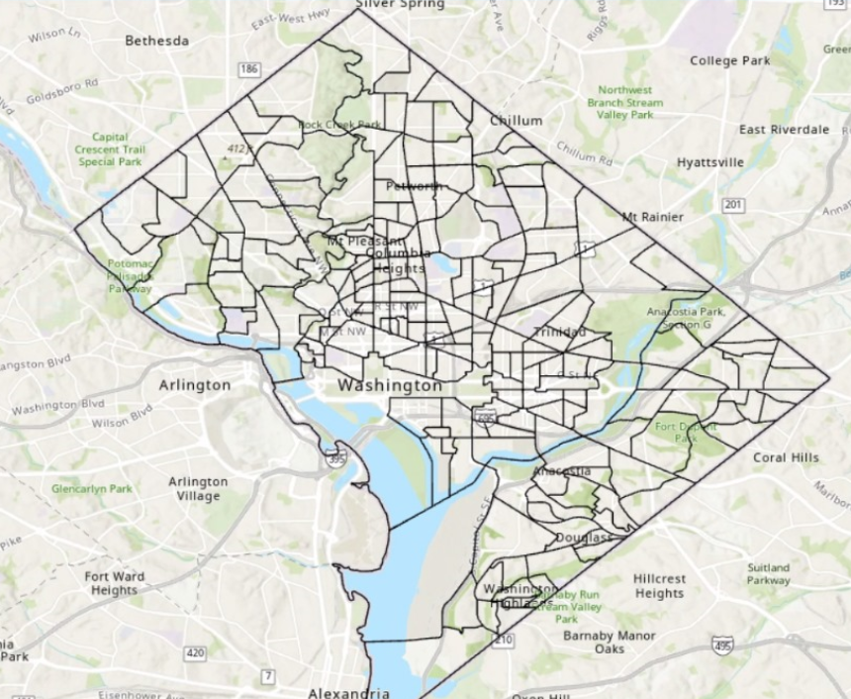
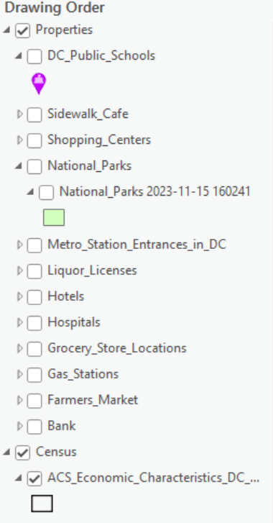
Dataset Description
Picture of DC Map along with some of the properties we used in this project

Slide 7
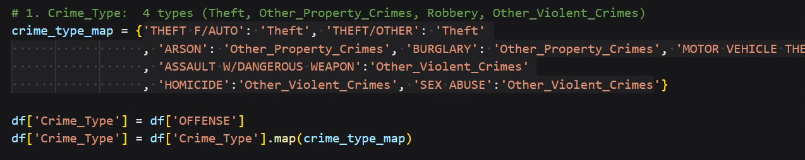
Data Engineering
Here we performed 3 main tasks to make our data ready for further analysis:
Data Consolidation:
Merged five datasets spanning from 2019 to 2023 into a single comprehensive dataset.
This integration provided a holistic view of crime trends over a five-year period in Washington, DC.
Crime Category Simplification:
Original data contained numerous crime types.
Simplified and categorized these into four main categories, following a methodology from a referenced research paper.
This categorization aids in clearer analysis and understanding of predominant crime types.

Slide 8
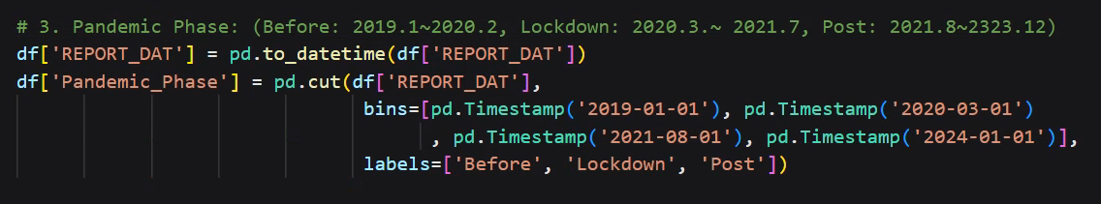
Data Engineering
Temporal Feature Addition:
Analyzed the 'REPORT_DATE' attribute to introduce a new feature: 'Time Region'.
Classified data into three time regions: Before Pandemic, Pandemic ,Post Pandemic
This temporal segmentation allows for focused analysis on the impact of COVID-19 on crime trends.

Slide 9
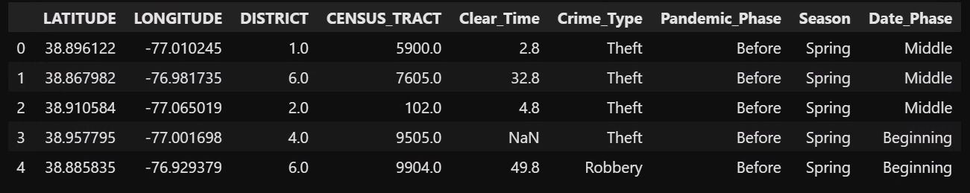
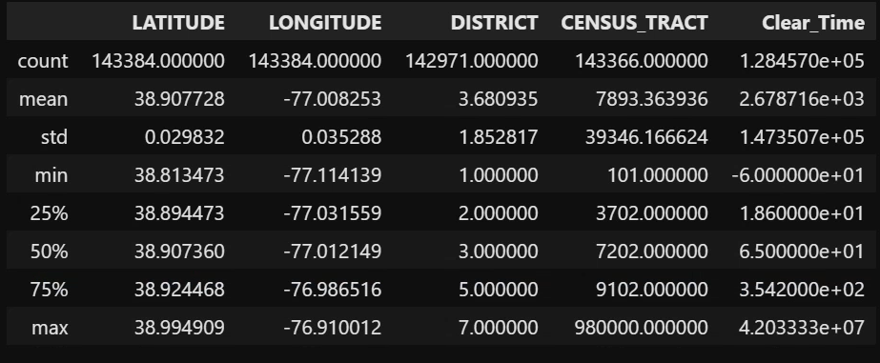
Data Engineering

Slide 10
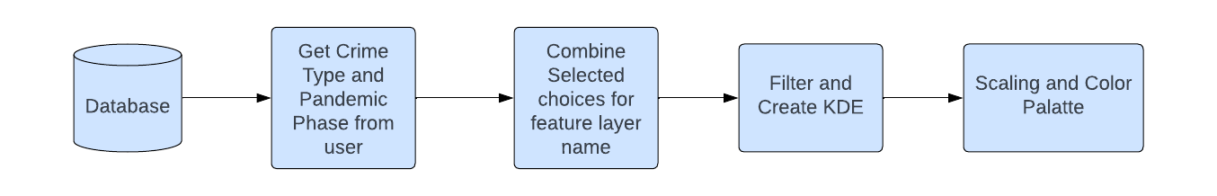
Methodology for Crime Analysis
Notes:
Define User Input Function:
get_user_input() function displays options and takes user input based on the provided dictionary of options.
Choose Crime Type:
User selects a crime type from the given options: Theft, Other Property Crimes, Robbery, Other Violent Crimes.
Choose Pandemic Phase:
User selects a pandemic phase from the options: Before, Lockdown, Post.
Apply Filter and Create KDE:
Selects data matching the specified criteria using arcpy.SelectLayerByAttribute_management.
Sets up the environment using arcpy.EnvManager to define the extent for analysis.
Generates a Kernel Density Estimation (KernelDensity) layer for the selected data.
Exception Handling:
Catches and handles any execution errors that might occur during the process.
Define User Input Function:
get_user_input() function displays options and takes user input based on the provided dictionary of options.
Choose Crime Type:
User selects a crime type from the given options: Theft, Other Property Crimes, Robbery, Other Violent Crimes.
Choose Pandemic Phase:
User selects a pandemic phase from the options: Before, Lockdown, Post.
Apply Filter and Create KDE:
Selects data matching the specified criteria using arcpy.SelectLayerByAttribute_management.
Sets up the environment using arcpy.EnvManager to define the extent for analysis.
Generates a Kernel Density Estimation (KernelDensity) layer for the selected data.
Exception Handling:
Catches and handles any execution errors that might occur during the process.

Slide 11
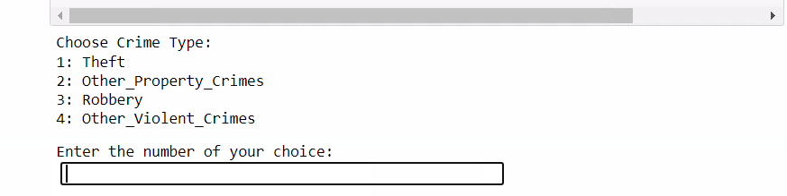
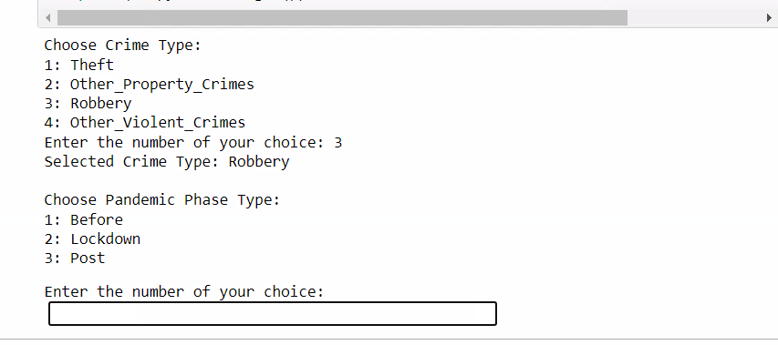
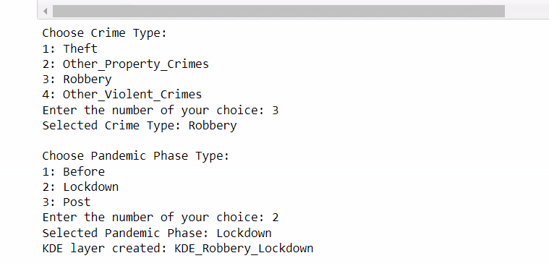
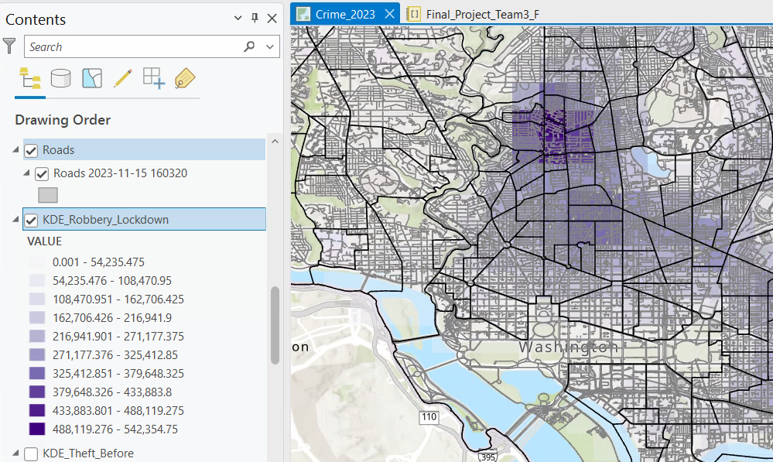
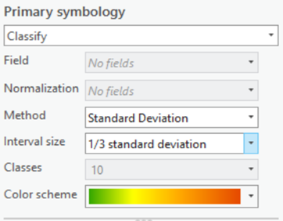
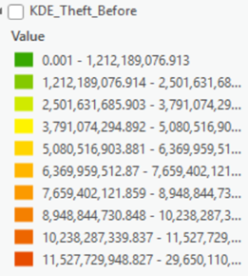
User Interactive Tool
Notes:
Dark Green is safest and Dark Red is more violent.

Slide 12
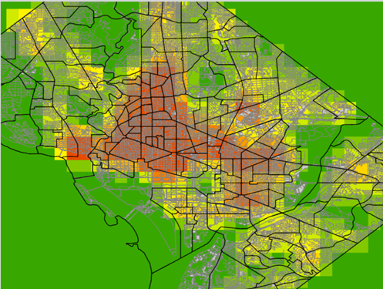
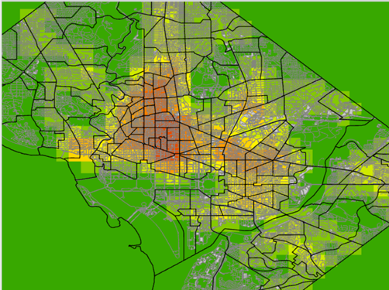

Analysis of Crime Type : Theft
Before Pandemic Pandemic Post Pandemic
Notes:
Hotspot zone is more concentrated in center for before pandemic and getting reduced for pandemic and post pandemic.

Slide 13
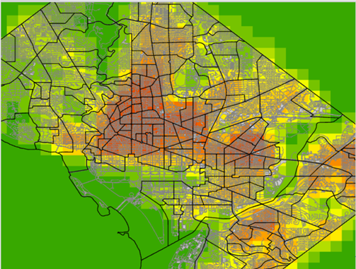
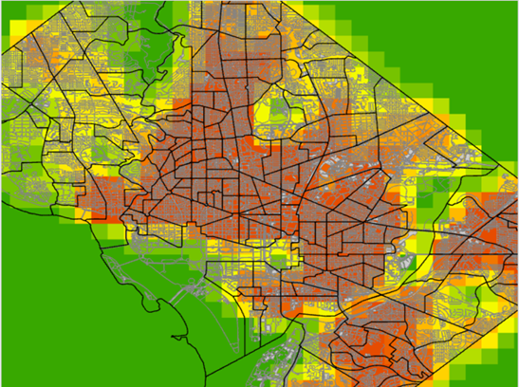
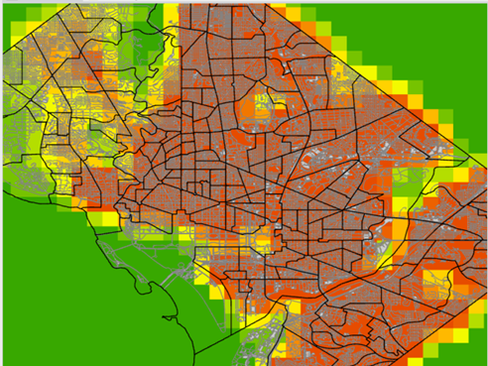
Analysis of Crime Type : Other Property Related Crimes
(ARSON, BURGLARY, MOTOR VEHICLE THEFT)
Before Pandemic Pandemic Post Pandemic
Notes:
No of crime incidents increases over the period of pandemic and post pandemic.

Slide 14
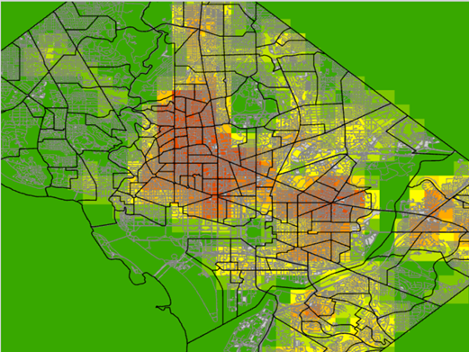
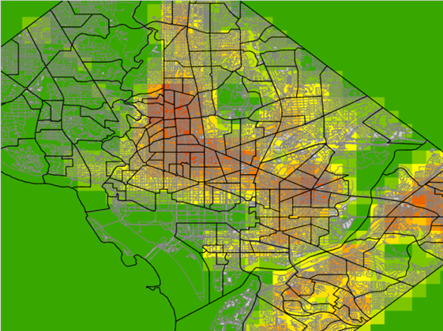
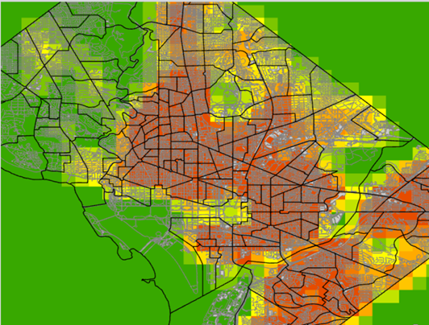
Analysis of Crime Type : Robbery
Before Pandemic Pandemic Post Pandemic

Slide 15
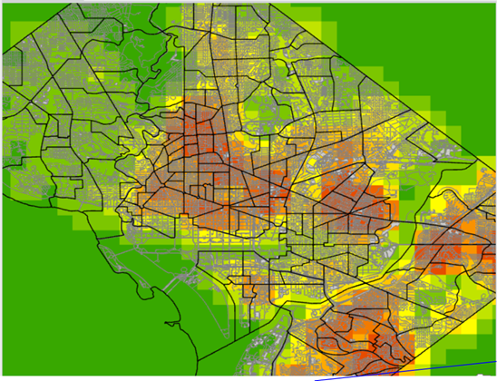
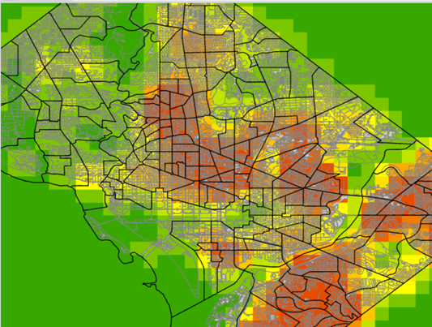
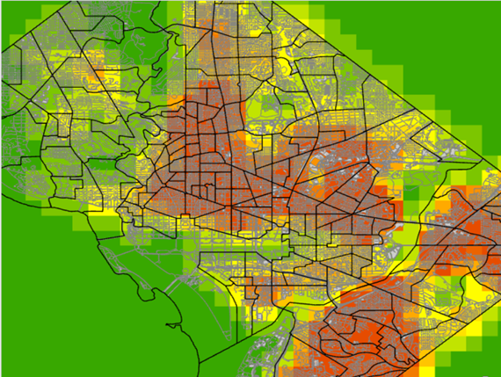
Analysis of Crime Type : Other Violent Related Crimes
(ASSAULT, HOMICIDE, SEX ABUSE)
Before Pandemic Pandemic Post Pandemic

Slide 16
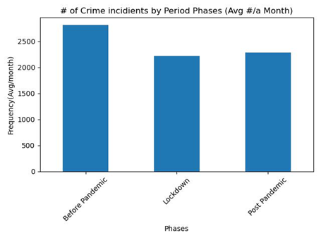
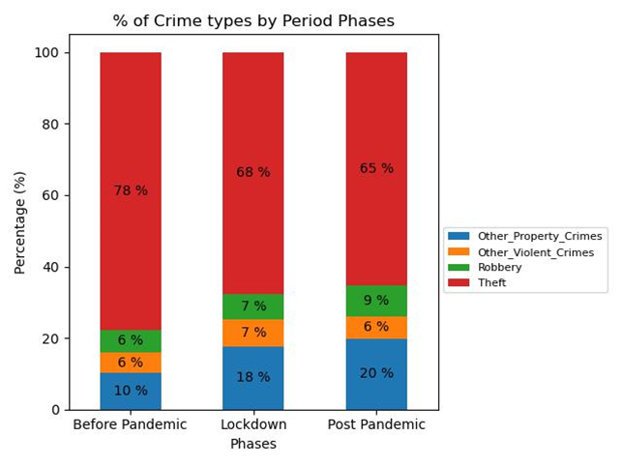
Trend Analysis
Overall Trend of Crime across different phases of pandemic:

Slide 17
Methodology for Proximity Feature Analysis
Notes:
Calculate Geometry:
Import Crime_Incidents_19_23 and Liquor_Licenses datasets into the GIS workspace.
Validate and prepare spatial data for analysis.
Create Buffers:
Use Buffer_analysis to create a 500-foot radius around each crime incident to identify potential impact zones.
Spatial Intersection:
Apply Intersect_analysis to find liquor-licensed properties within the crime incident buffers.
Generate an intersected feature class for spatial correlation analysis.
Data Analysis with Python:
Employ Python's arcpy.da.SearchCursor to iterate and count properties within each crime buffer.
Populate a dictionary mapping each buffer ID to its corresponding property count.
Update Feature Class:
Add a new field PropertyCount to the Crime_Buffer feature class.
Update the feature class with the counts of liquor-licensed properties in proximity to crime incidents.

Slide 18
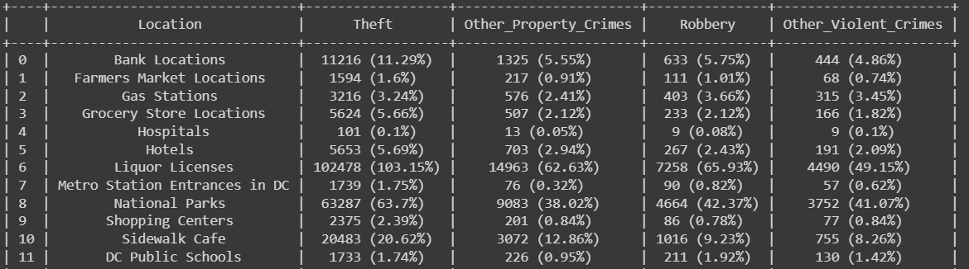
Proximity Feature Analysis
We calculated the number of properties within 100m(300 feet) of given crime location.

Slide 19
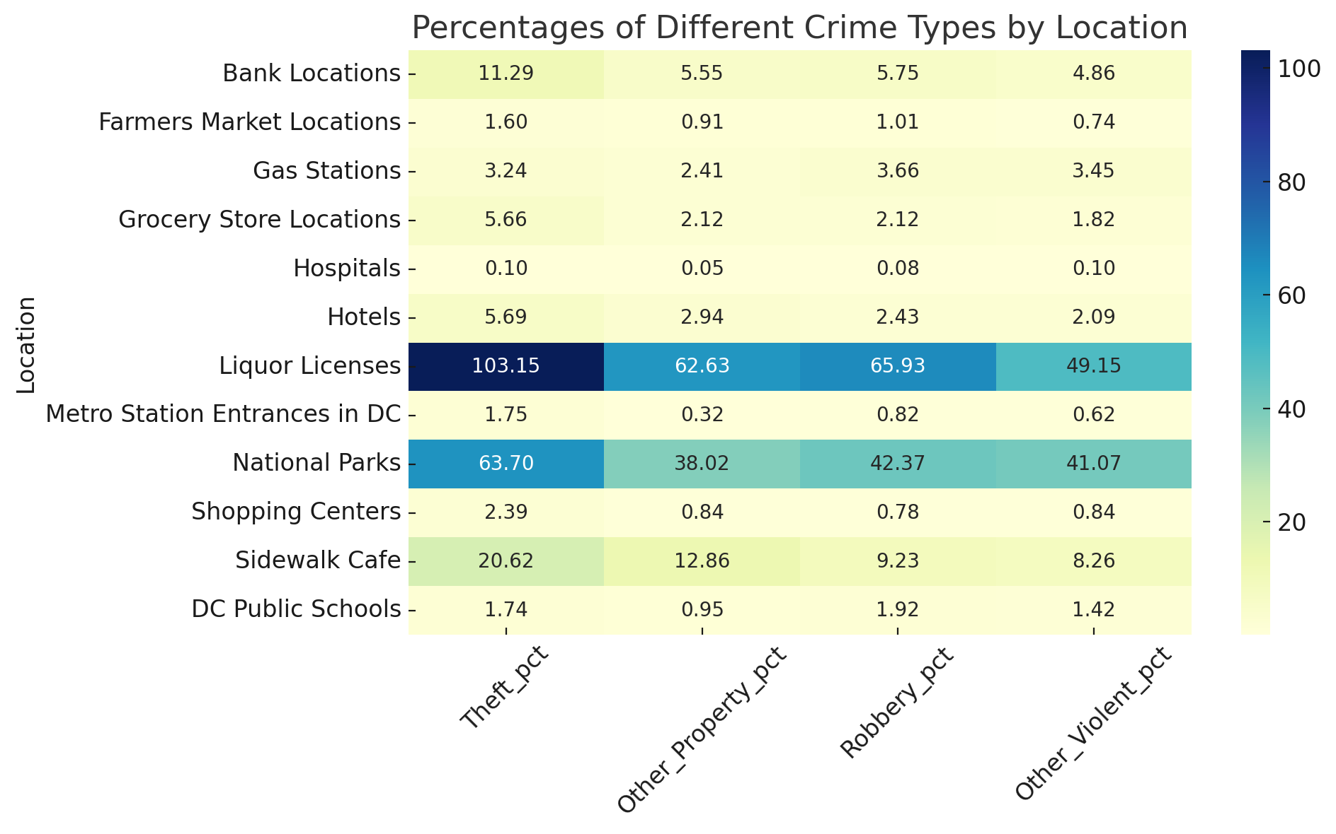
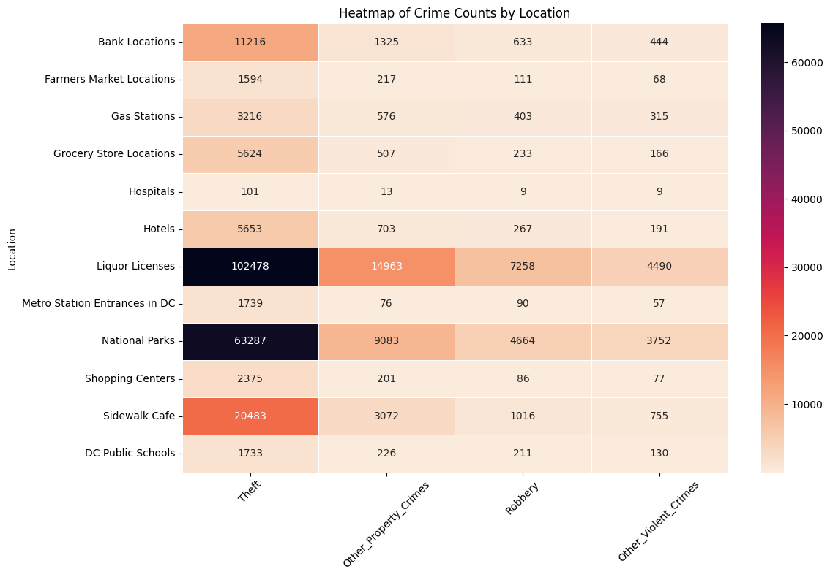
Proximity Feature Analysis
Confusion Matrix:

Slide 20
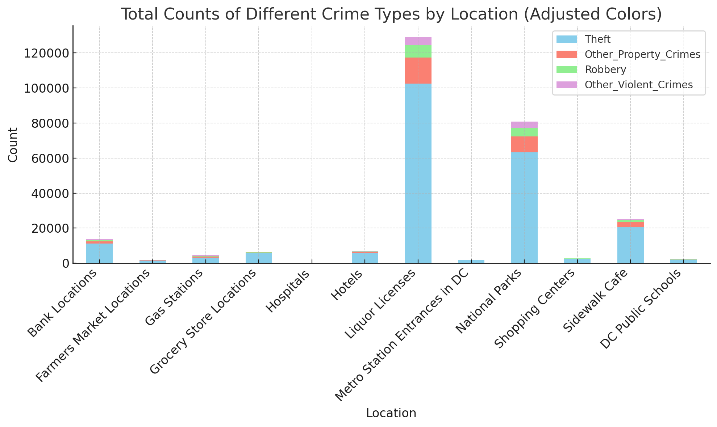
Proximity Feature Analysis
Distribution of Crime across different location:

Slide 21
Conclusion
Impact of COVID-19 on Crime Trends:
Our analysis revealed distinct shifts in crime patterns during the Pre-COVID, COVID, and Post-COVID periods.
These shifts underscore the significant impact of socio-economic changes, particularly during public health crises, on urban crime dynamics.
Crime Proximity to Urban Features:
The proximity analysis showed specific crime types occurring within 300 feet(100m) of key locations like schools, police stations, and grocery stores.
This insight also shows that location like liquor stores and parks are crime hotspots within DC
Advancements in Crime Data Analysis:
Utilizing GIS technologies and Python enabled a more nuanced understanding of spatial crime patterns.
Our interactive tool represents a significant step forward in making crime data analysis more accessible and informative for users.

Slide 22
Future Use Cases
Adaptability to Other Urban Areas:
The methodologies and tools developed can be adapted to analyze crime data in different urban settings.
This flexibility allows for comparative studies between cities, enhancing understanding of urban crime on a broader scale.
Integration with Urban Planning and Safety Strategies:
Insights from our analysis can inform urban planning, particularly in designing safer city landscapes.
Policymakers and law enforcement agencies can utilize this data for targeted crime prevention and resource allocation.
Enhancement with Real-Time Data Analysis:
Future iterations of the project could integrate real-time crime data, providing up-to-the-minute insights for more immediate responses.
This would be particularly beneficial for rapid deployment of law enforcement resources in high-crime areas.
Incorporation of Additional Variables:
Including more socio-economic and demographic data could provide a deeper understanding of the underlying causes of crime.
This expanded analysis could lead to more effective, community-specific crime prevention strategies.

Slide 23
Reference
Crime risk prediction incorporating geographical spatio temporal dependency into machine learning models https://doi.org/10.1016/j.ins.2023.119414
The use of predictive analysis in spatiotemporal crime forecasting: Building and testing a model in an urban context https://doi.org/10.1016/j.apgeog.2017.06.011
Open Data DC (2023). Retrieved from https://opendata.dc.gov/search?collection=Dataset&q=crime
Economic Characteristics of DC Census Tracts. Retrieved from https://opendata.dc.gov/datasets/DCGIS::acs-economic-characteristics-dc-census-tract/explore?location=38.893677%2C-77.014562%2C12.07
Boman, J. H., Gallupe, O. (2020). Has COVID-19 Changed Crime? Crime Rates in the United States during the Pandemic. American Journal of Criminal Justice, 45(4), 525–547. https://doi.org/10.1007/s12103-020-09551-3
Council of the District of Columbia (NA).. Retrieved from https://code.dccouncil.gov/us/dc/council/code/sections/22-2801

